Slide 1
Project Update-02/11
Wei Fan

Slide 2
Dataset
2 raw datasets
1. execution status of 110 applications(benchmarks)
(including resource pressure(e.g. memory bandwidth, disk i/o), performance(e.g. latency) )
2. time series data on some target applications’ performance
(including time series, applications’ performance(e.g. response time from server to client))
Notes:
There are two raw datasets be used in project. One dataset, which includes 110 benchmarks’ execution status and system resource pressure, used for the construction of design space for FECBench, provides data for data view and clustering visualization. In raw dataset, there are some empty attributes and missing values, I cleaned dataset by removing empty attributes and substituting missing values by average values. I also combine data items with same benchmark name and make a distinct benchmark execution status subset.
The second dataset contains time series data on target applications’ performance. I proposed to use it to present a real time monitoring view and use RNN to get a performance prediction. However the data provider cannot send me the data until the first week of March. So at this time I use some random generated data.

Slide 3
Libraries
D3.js
Chart.js
Notes:
I use D3 to do the visualizations and use flask framework to support communication from backend to frontend.

Slide 4
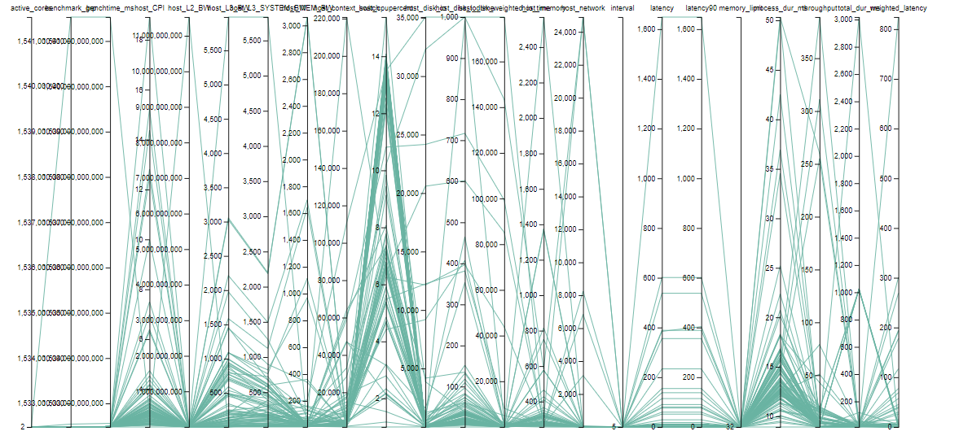
Initial views
Notes:
To provide an original data view, I use Parallel Coordinates. The dataset has about 23 dimensions.

Slide 5
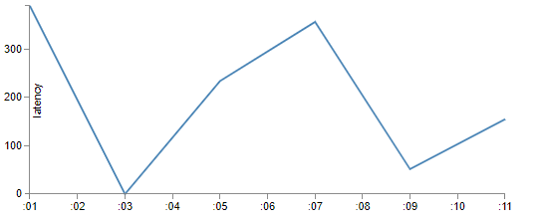
Initial views
Time series data
monitoring
Notes:
I use simple line chart to show the real time performance of target applications right now. I’m considering about adding additional markers to show the system pressure at each time.

Slide 6
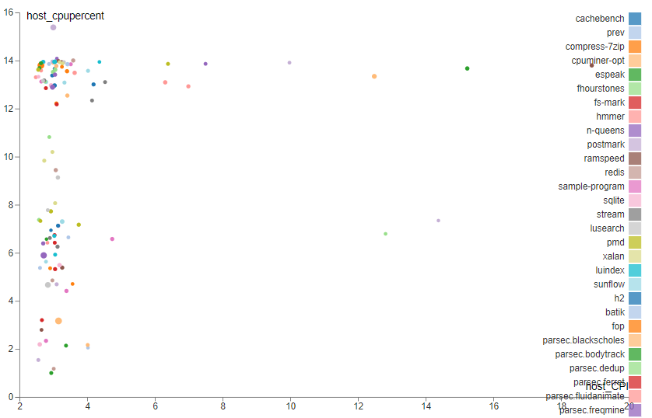
Initial views
Notes:
I also conducted Principal Component Analysis to get the two dimensions projection. I haven’t done clustering yet so the colors here represent all benchmarks. After clustering, the color will represent each cluster.

Slide 7
Thank you!

